Slide 1

Group 21 (110850 & 110771)
Semester project

Slide 2
21. Online Learning Platform with Live Sessions and Peer Reviews
Question:
Students enroll in online courses that consist of recorded lectures, live sessions, assignments and peer-reviewed projects. Teachers create assignments and moderate peer reviews. Each live session has a scheduled time and attendance tracking. Students submit reviews anonymously, and the system flags overly biased or unfair evaluations. Certificates are auto-generated upon course completion.

Slide 3
Online Learning Platform with Live Sessions and Peer Reviews
Integrated Learning Experience
01
Anonymous Peer Reviews with Bias Detection
02
Automated Certification
03

Slide 4
Entities & Attributes
1. Students( Student_Id PRIMARY KEY, Student Name, Phn_no )
Student_Id PRIMARY KEY
2. Teacher( Teacher_Id PRIMARY KEY, Teacher Name, Phn_no)
Teacher_Id PRIMARY KEY
3. Course( Course Code PRIMARY KEY, Course Name)
Course Code PRIMARY KEY
4. Certificate( Certificate Id PRIMARY KEY, Course Code FOREIGN KEY REFERENCES, Issue Date, Grade)
Certificate Id PRIMARY KEY
5. Assignment( Assign_Id PRIMARY KEY, Due Date, Course Code)
Assign_Id PRIMARY KEY

Slide 5
5. Assignment( Assign_Id PRIMARY KEY, Due Date, Course Code)
Assign_Id PRIMARY KEY
6. Project( Project Id PRIMARY KEY, Title, Submission Type)
Project Id PRIMARY KEY
7. Live Session ( Session_Id PRIMARY KEY, Schedule Time, Attendance)
Session_Id PRIMARY KEY
8. Lecture ( Lecture_Id PRIMARY KEY, Course_Id, Duration)
Lecture_Id PRIMARY KEY
9. Peer Review ( Reviewer_Id PRIMARY KEY, Is Anonymous BOOLEAN, Is Flagged)
Reviewer_Id PRIMARY KEY

Slide 6
Relationship
A student can enroll in many courses, and each course can have many students.
A student may submit multiple assignments, and each assignment may have multiple student submissions.
Upon completing a course, a certificate is issued.
A teacher can conduct multiple live sessions, live session has multiple teachers.
A live session is typically based on a lecture, and potentially multiple sessions can refer to the same lecture.
Each live session can have multiple peer reviews.

Slide 7
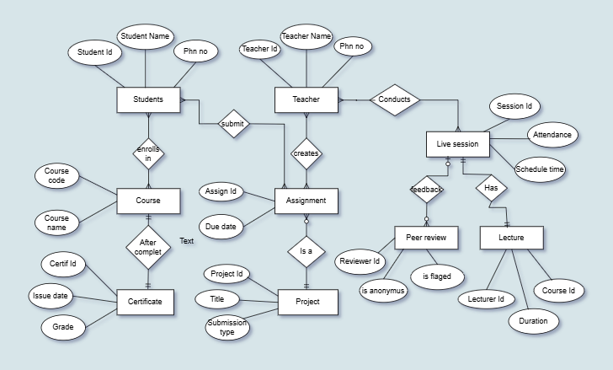
ER Diagram

